Slide 1
AVL Trees

Slide 2
Motivation
3
5
13
8
5
20
13
18
3
8
18
22
20
22

Slide 3
AVL Tree
AVL (Adelson-Velsky and Landis) Trees
An AVL tree is a binary search tree in which
  for every node in the tree, the height of the left and right subtrees differ by at most 1.
Property: height of balanced tree of n nodes is O(log n).
Height factor h_{f} = h_{L} – h_{R}
h_{f} = -1, 0, 1
13
5
20
3
8
22
10

Slide 4
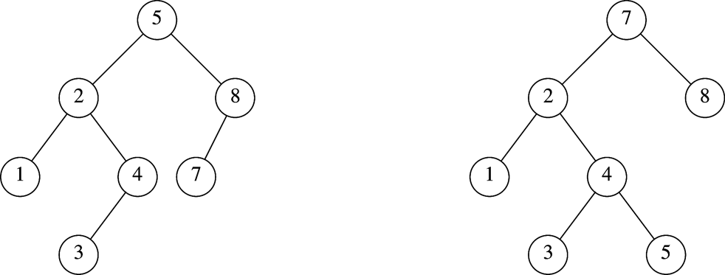
Which is an AVL Tree?

Slide 5
Balance Condition Violation
If condition violated after a node insertion
  Which nodes do we need to rotate?
  Only nodes on path from insertion point to root may have their balance altered
Rebalance the tree through rotation at the deepest node with balance violated
  The entire tree will be rebalanced
Violation cases at node k (deepest node)
  An insertion into left subtree of left child of k
  An insertion into right subtree of left child of k
  An insertion into left subtree of right child of k
  An insertion into right subtree of right child of k
  Cases 1 and 4 equivalent
    Single rotation to rebalance
  Cases 2 and 3 equivalent
    Double rotation to rebalance

Slide 6
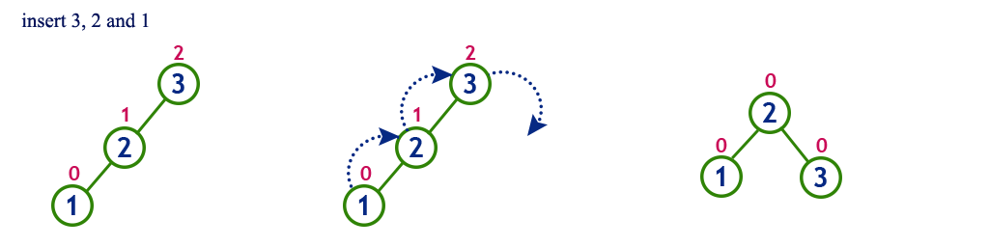
LL Rotation

Slide 7
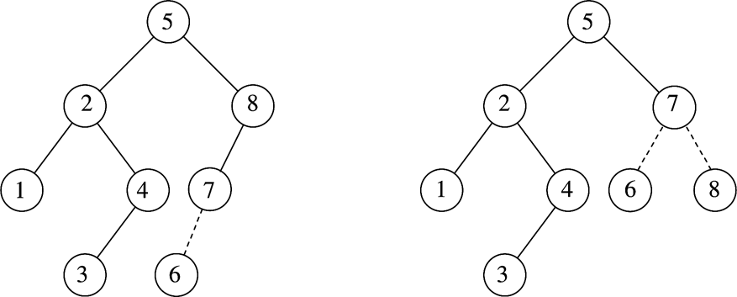
LL Rotation - Example

Slide 8
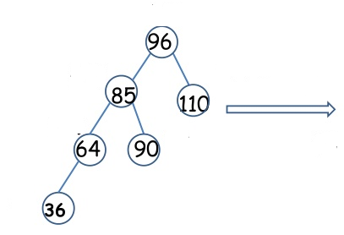
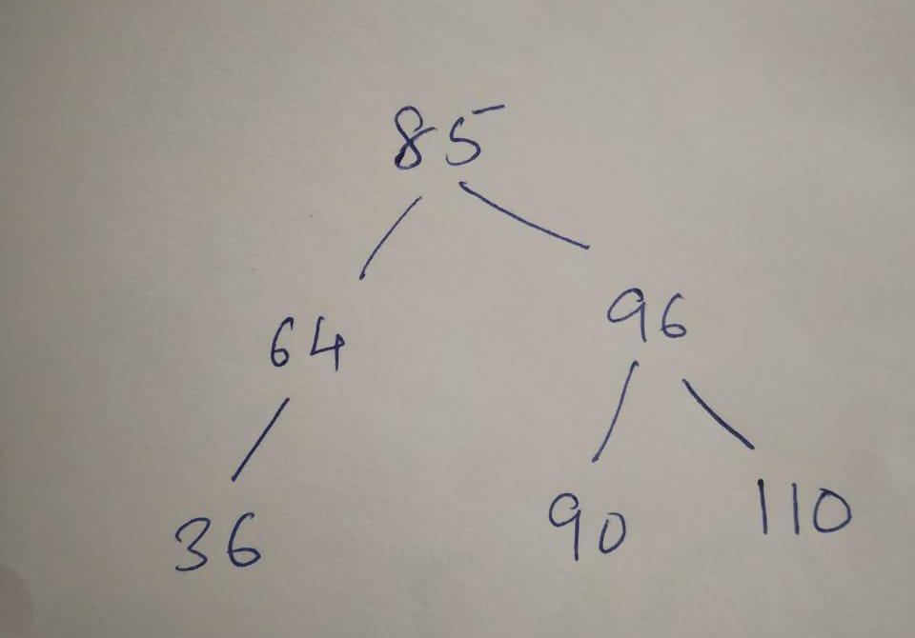
LL Rotation - Example

Slide 9
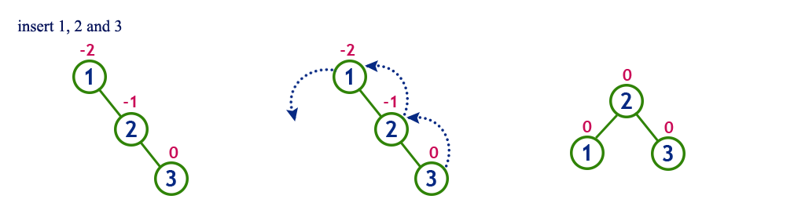
RR Rotation

Slide 10
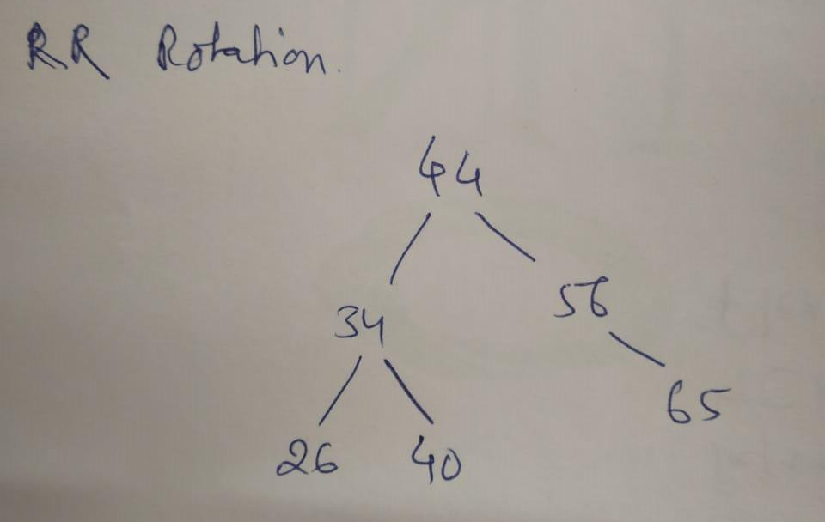
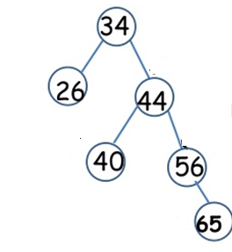
RR Rotation

Slide 11
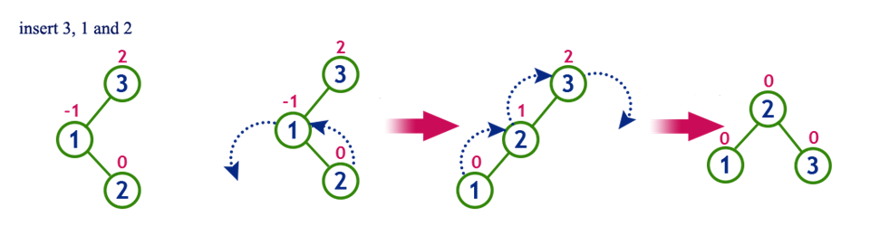
LR Rotation = Right branch rotation + LL Rotation

Slide 12
LR Rotation
Construct AVL tree for the list by successive insertion
5, 6, 8, 3, 2, 4
RR(5), LL(5), LR(6)

Slide 13
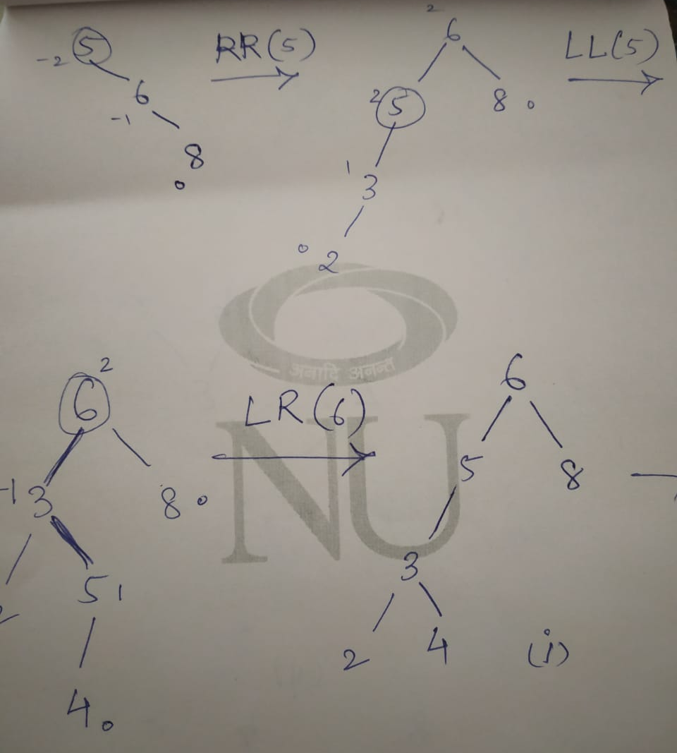

Slide 14
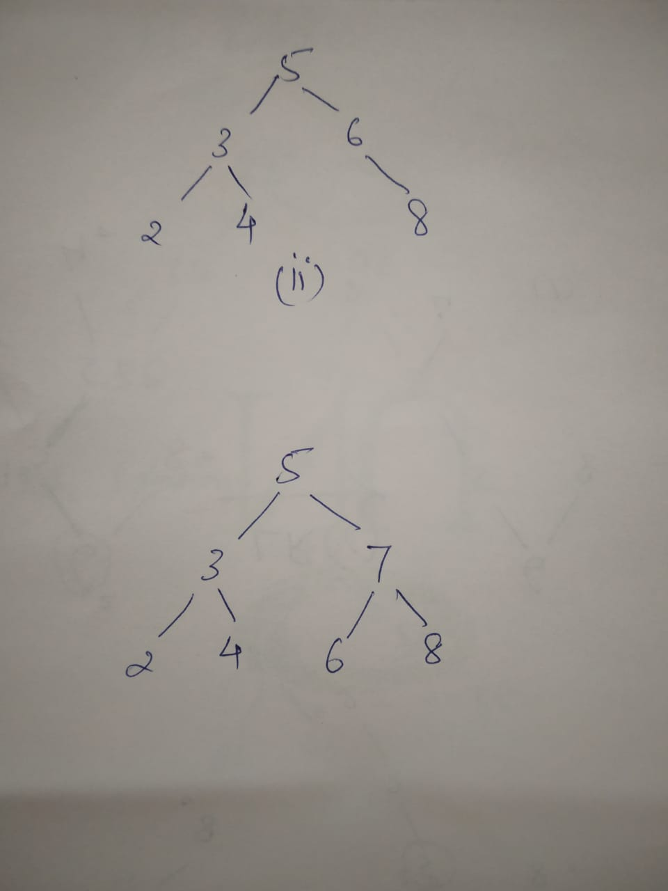

Slide 15
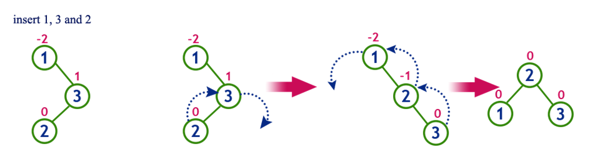
RL Rotation = Left branch rotation + RR Rotation

Slide 16
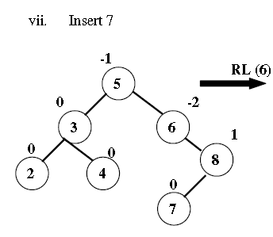
RL Rotation

Slide 17
RL Rotation

Slide 18
RL Rotation Example (Cont’d)
Inserting 14
4
2
6
1
3
5
15
7
16
14

Slide 19
RL Rotation Example (Cont’d)
Inserting 14
4
4
2
7
2
6
1
3
6
15
1
3
5
15
14
16
7
16
5
14

Slide 20
AVL Tree Construction
Insert 14, 17, 11, 7, 53, 4, 13, 12, 8 into an empty AVL tree

Slide 21
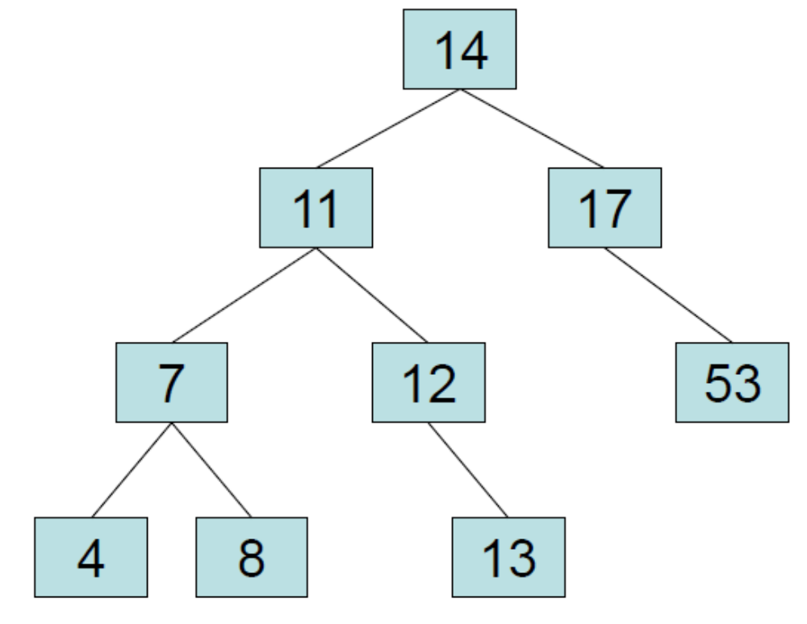
AVL Tree Construction
Insert 14, 17, 11, 7, 53, 4, 13, 12, 8 into an empty AVL tree

Slide 22
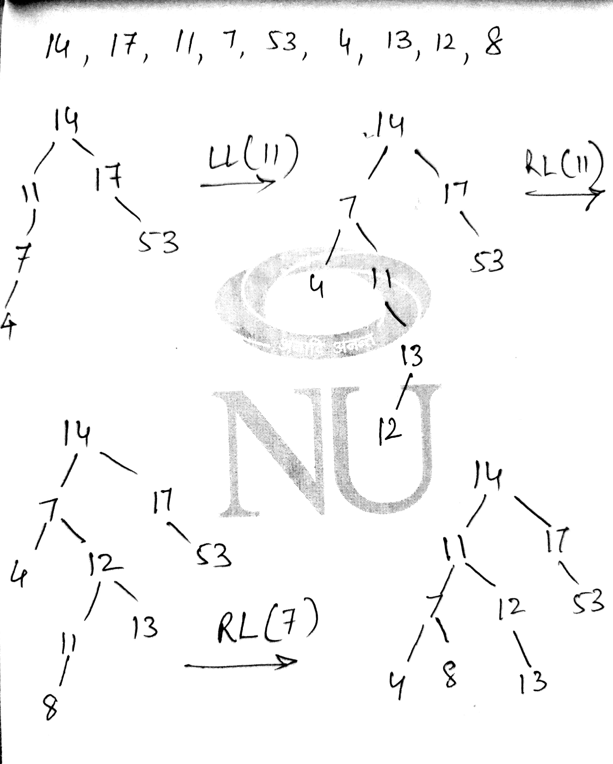

Slide 23
Deletion Example
20
10
35
5
15
25
40
18
30
38
45
50
Delete 5
Node 10 is unbalanced

Slide 24
Cont’d
20
15
35
10
18
25
40
30
38
45
Continue to check parents
50
For deletion, after rotation, we need to continue tracing upward to see if AVL-tree property is violated at other node.

Slide 25
Cont’d
20
35
15
35
20
40
10
18
25
40
15
25
38
45
30
38
45
10
18
30
50
Continue to check parents
50
Node 20 is unbalanced!!
For deletion, after rotation, we need to continue tracing upward to see if AVL-tree property is violated at other node.

Slide 26
Deletion in AVL Tree
Delete 53, 11, 8

Slide 27
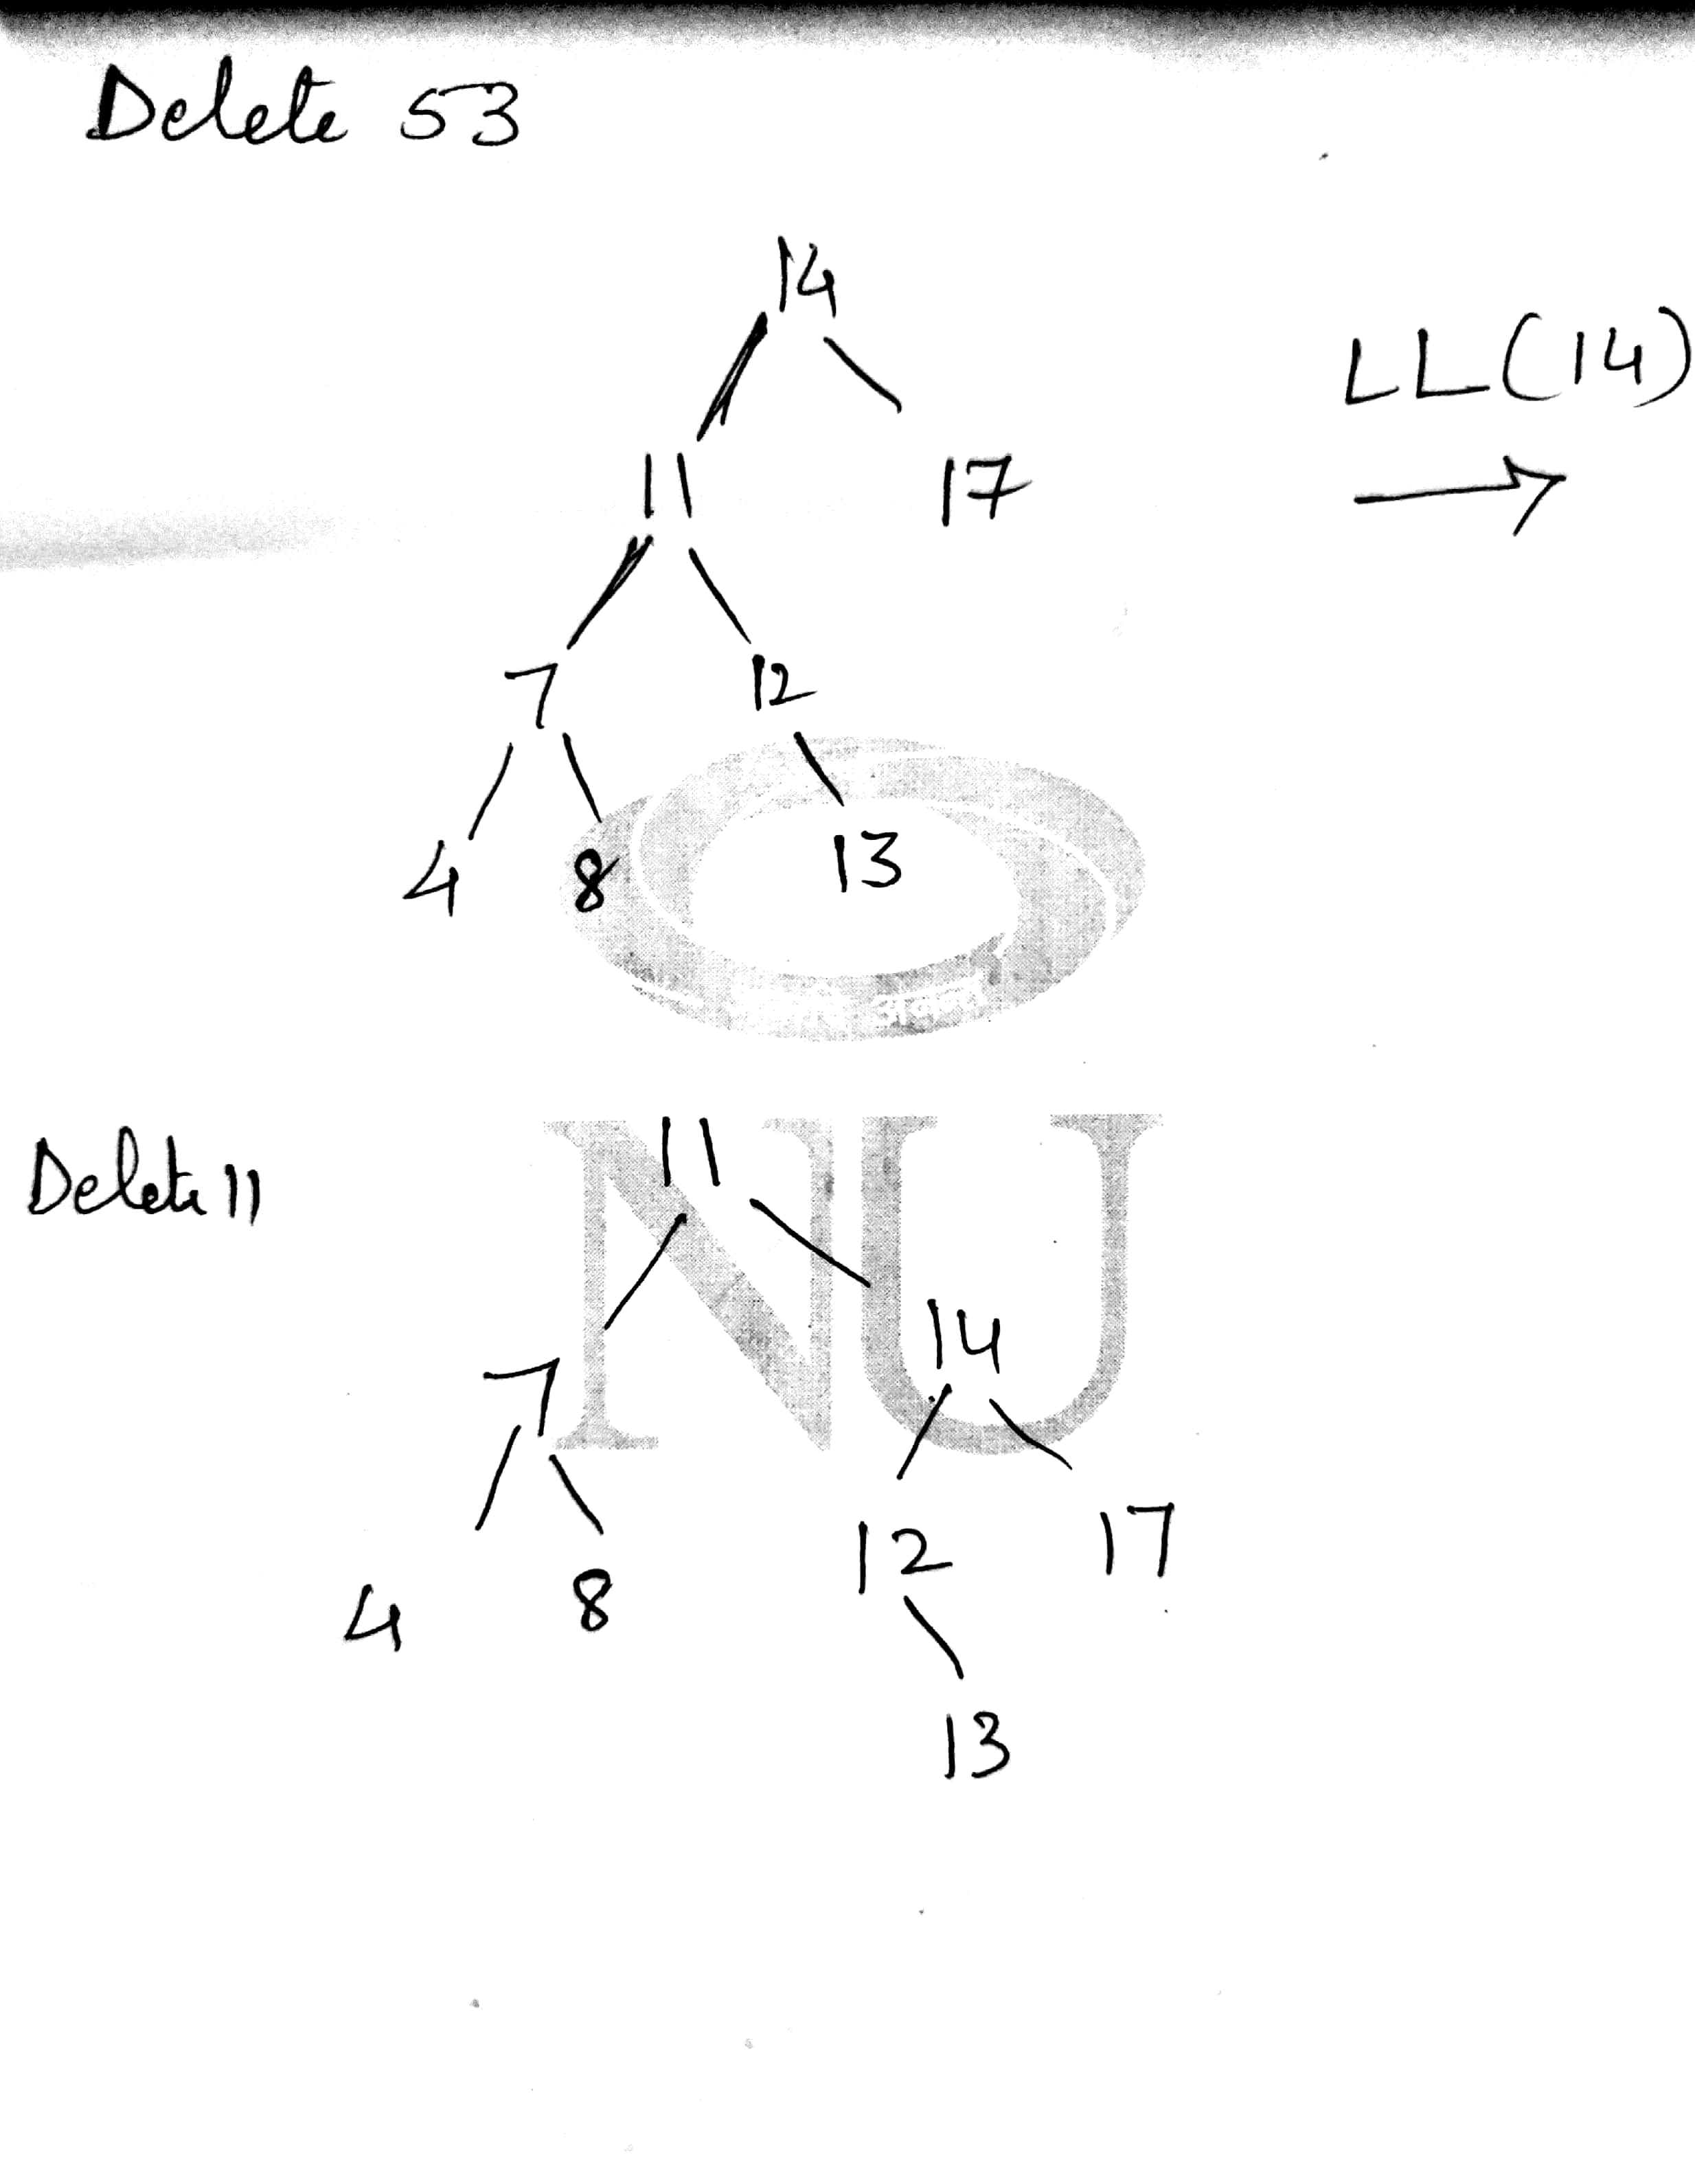

Slide 28
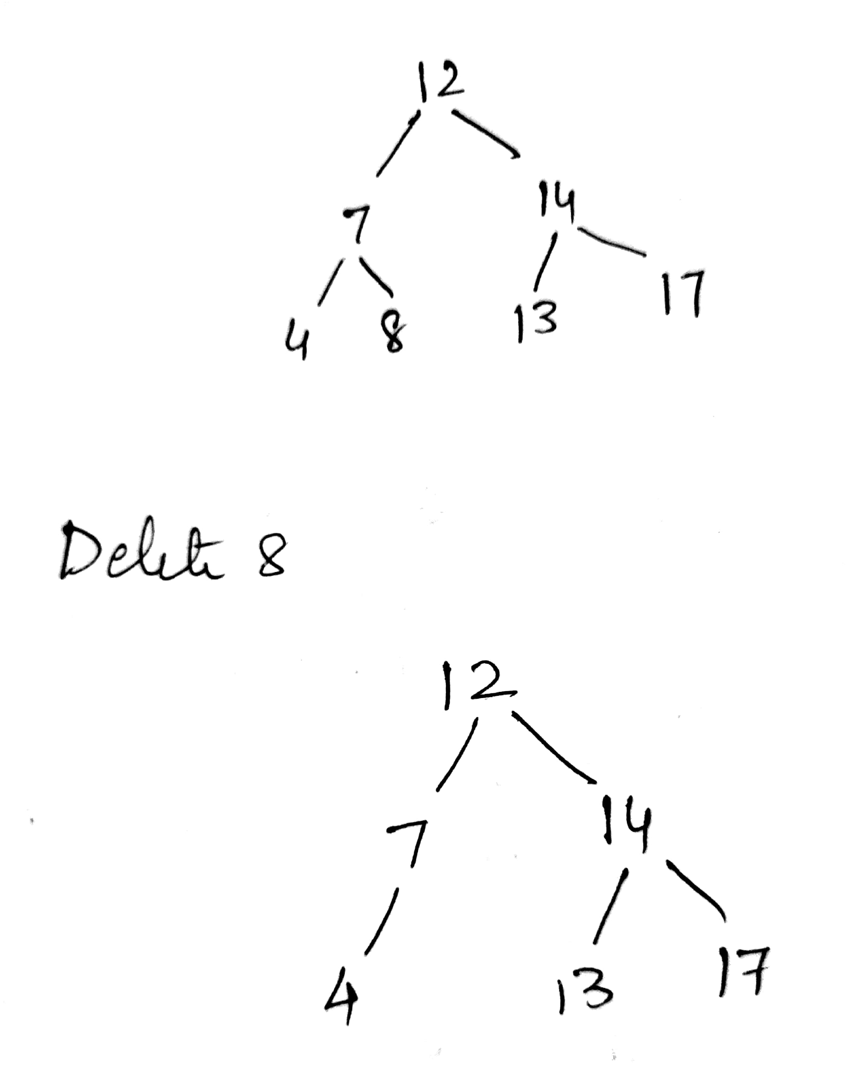

Slide 29
Construction of AVL Tree
Build an AVL tree with the following values:
15, 20, 24, 10, 13, 7, 30, 36, 25

Slide 30
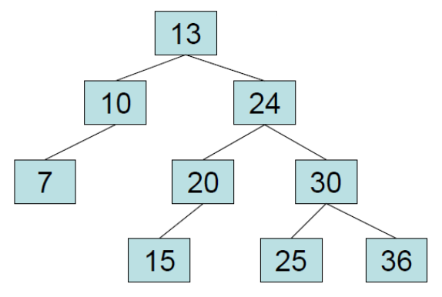
Now Remove 24, 20

Slide 31
Red Black Tree

Slide 32
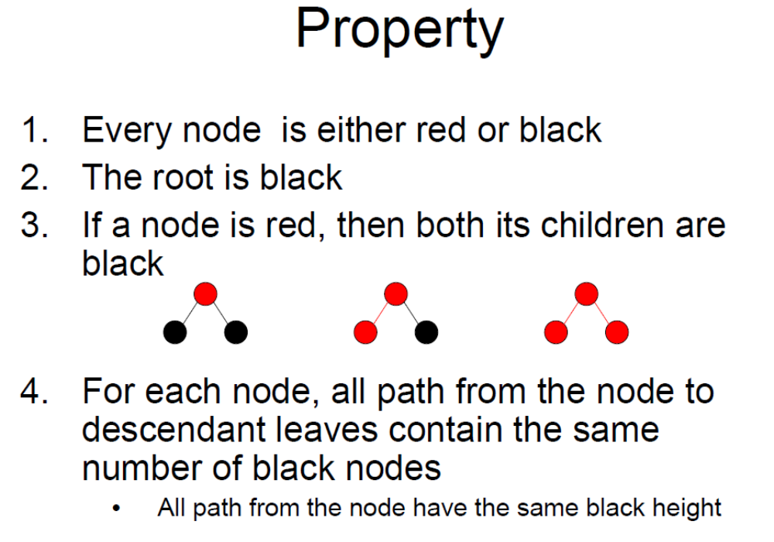

Slide 33
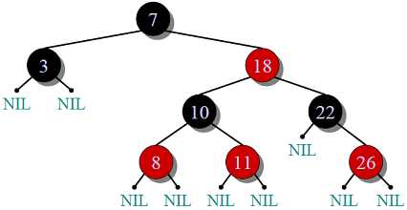

Slide 34
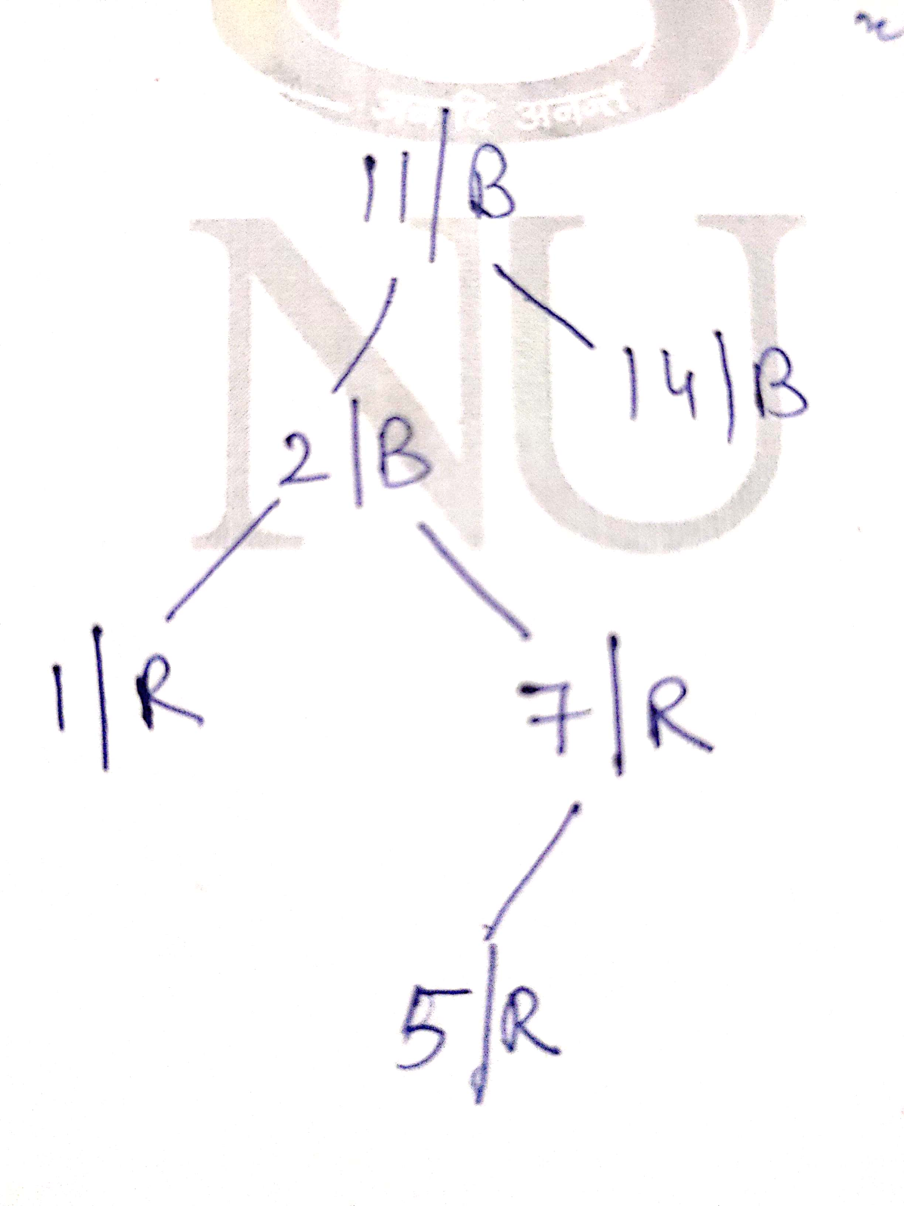

Slide 35
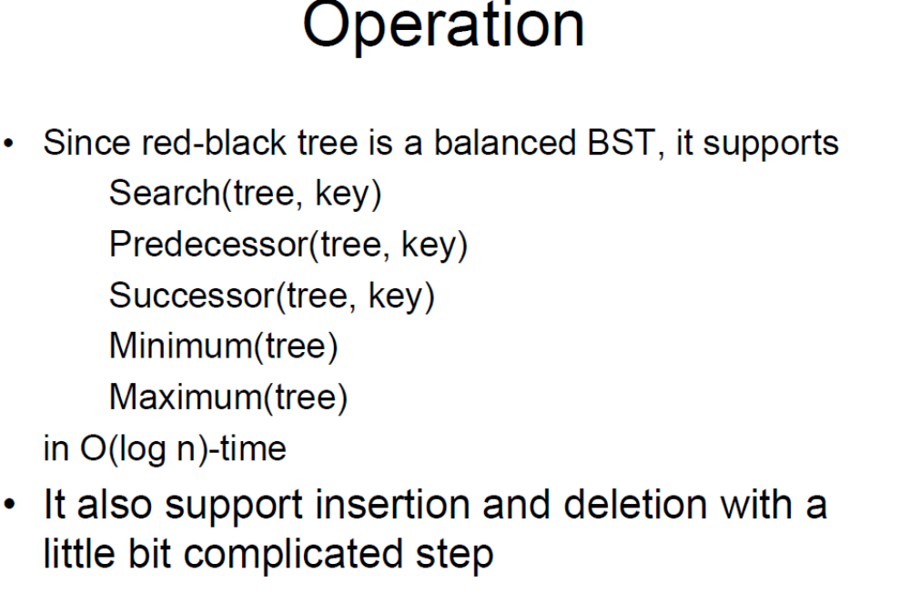

Slide 36
Red Black Tree creation
In AVL tree insertion, we used rotation as a tool to do balancing after insertion caused imbalance. In Red-Black tree, we use two tools to do balancing.
1) Recoloring
2) Rotation
We try recoloring first, if recoloring doesn’t work, then we go for rotation. Following is detailed algorithm. The algorithms has mainly two cases depending upon the color of uncle. If uncle is red, we do recoloring. If uncle is black, we do rotations and/or recoloring.
Color of a NULL node is considered as BLACK.

Slide 37
Let x be the newly inserted node.
1) Perform standard BST insertion and make the color of newly inserted nodes as RED.
2) If x is root, change color of x as BLACK (Black height of complete tree increases by 1).
3) Do following if color of x’s parent is not BLACK and x is not root.
….a) If x’s uncle is RED (Grand parent must have been black from property 4)
……..(i) Change color of parent and uncle as BLACK.
……..(ii) color of grand parent as RED.
……..(iii) Change x = x’s grandparent, repeat steps 2 and 3 for new x.

Slide 38
b) If x’s uncle is BLACK, then there can be four configurations for x, x’s parent (p) and x’s grandparent (g) (This is similar to AVL Tree)
……..i) Left Left Case (p is left child of g and x is left child of p)
……..ii) Left Right Case (p is left child of g and x is right child of p)
……..iii) Right Right Case (Mirror of case i)
……..iv) Right Left Case (Mirror of case ii)

Slide 39
Ques 1. Create Red Black Tree for the following:
10, 5, 60, 25, 1, 23

Slide 40
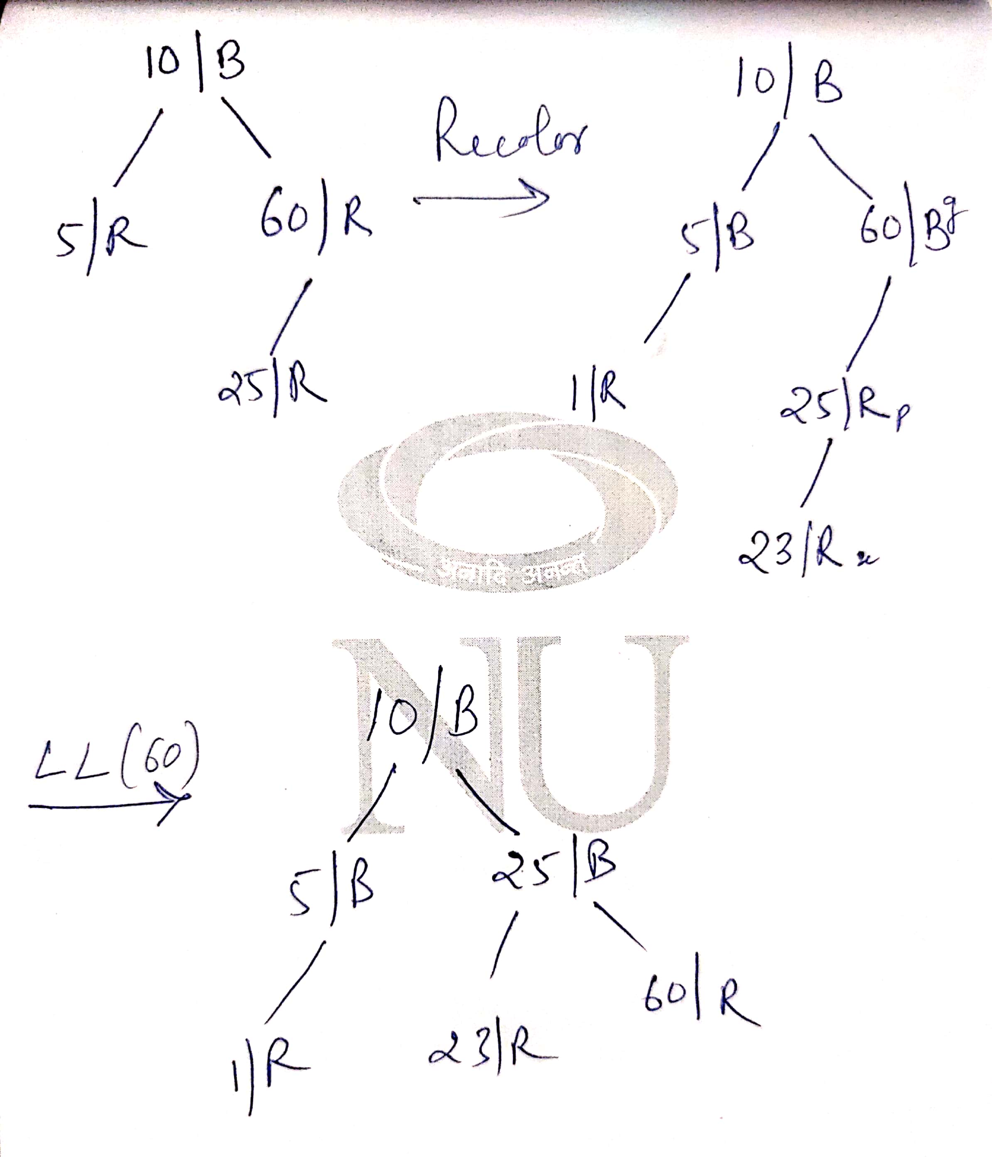

Slide 41
Ques 2. Create Red Black Tree for the given sequence:
11, 1, 14, 2, 7, 15, 5, 8, 4

